Slide 1
Transformer Anatomy
Natural Language Processing with Transformers
Building Language Applications with Hugging Face
이용환

Slide 2
Introduction
Seq2seq and Attention

Slide 3
Introduction(Neural Network)
Output
Neural
Network
Input

Slide 4
Introduction(Recurrent Neural Network)
Output
Neural
Network
Input

Slide 5
Introduction(Recurrent Neural Network)
Output
Output
Output
Output
Neural
Network
Neural
Network
Neural
Network
Neural
Network
Input
Input
Input
Input

Slide 6
Introduction(Recurrent Neural Network)
Output
Output
Output
Output
Neural
Network
Neural
Network
Neural
Network
Neural
Network
Input
이전
Output
Input
이전
Output
Input
이전
Output
Input

Slide 7
Introduction(Seq2seq)
Output
Output
Output
Output
Neural
Network
Neural
Network
Neural
Network
Neural
Network
Context
vector
이전
Output
이전
Output
이전
Output
Neural
Network
Neural
Network
Neural
Network
Neural
Network
Input
이전
Output
Input
이전
Output
Input
이전
Output
Input

Slide 8
Introduction(Seq2seq)
Output
Output
Output
Output
Neural
Network
Neural
Network
Neural
Network
Neural
Network
Encoder
Context
vector
이전
Output
이전
Output
이전
Output
Neural
Network
Neural
Network
Neural
Network
Neural
Network
Input
이전
Output
Input
이전
Output
Input
이전
Output
Input

Slide 9
Introduction(Seq2seq)
Output
Output
Output
Output
Neural
Network
Neural
Network
Neural
Network
Neural
Network
Encoder
Context
vector
이전
Output
이전
Output
이전
Output
Decoder
Neural
Network
Neural
Network
Neural
Network
Neural
Network
Input
이전
Output
Input
이전
Output
Input
이전
Output
Input

Slide 10
Introduction(Attention)
Output
Output
Output
Output
Attention
Neural
Network
Neural
Network
Neural
Network
Neural
Network
Neural
Network
Output
Context
vector
이전
Output
이전
Output
이전
Output
Decoder
Neural
Network
Neural
Network
Neural
Network
Neural
Network
Input
이전
Output
Input
이전
Output
Input
이전
Output
Input
Encoder

Slide 11
Introduction(Attention)
Attention
Value
Output
Output
Output
Output
Attention
Neural
Network
Neural
Network
Neural
Network
Neural
Network
Neural
Network
Output
Context
vector
이전
Output
이전
Output
이전
Output
Decoder
Neural
Network
Neural
Network
Neural
Network
Neural
Network
Input
이전
Output
Input
이전
Output
Input
이전
Output
Input
Encoder

Slide 12

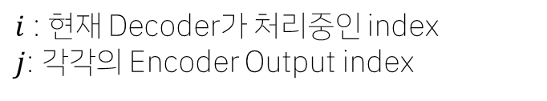







Introduction(Attention)
Attention
Value
Output=$s_{1}$
Output=$s_{2}$
Output=$s_{3}$
Output=$s_{4}$
Attention
Neural
Network
Neural
Network
Neural
Network
Neural
Network
Neural
Network
Output
$$h_{1}$$
$$h_{2}$$
$$h_{3}$$
$$h_{4}$$
Context
vector
이전
Output
이전
Output
이전
Output
Decoder
Neural
Network
Neural
Network
Neural
Network
Neural
Network
$i$ : 현재 Decoder가 처리중인 index
$j$: 각각의 Encoder Output index
Input
이전
Output
Input
이전
Output
Input
이전
Output
Input
Encoder

Slide 13
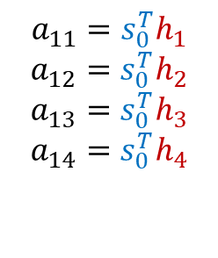
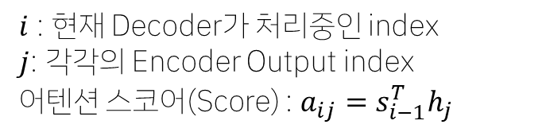







Introduction(Attention)
Attention
Value
$$a_{11}=s_{0}^{T}h_{1}$$
$$a_{12}=s_{0}^{T}h_{2}$$
$$a_{13}=s_{0}^{T}h_{3}$$
$$a_{14}=s_{0}^{T}h_{4}$$
$$s_{i} :$$
$$s_{1}$$
$$s_{2}$$
$$s_{3}$$
$$s_{4}$$
Attention
Neural
Network
Neural
Network
Neural
Network
Neural
Network
Neural
Network
Output
$h_{j}$ :
$$h_{1}$$
$$h_{2}$$
$$h_{3}$$
$$h_{4}$$
Context
vector
$$s_{0}$$
이전
Output
이전
Output
이전
Output
Decoder
Neural
Network
Neural
Network
Neural
Network
Neural
Network
$i$ : 현재 Decoder가 처리중인 index
$j$: 각각의 Encoder Output index
어텐션 스코어(Score) : $a_{ij}=s_{i−1}^{T}h_{j}$
Input
이전
Output
Input
이전
Output
Input
이전
Output
Input
Encoder

Slide 14
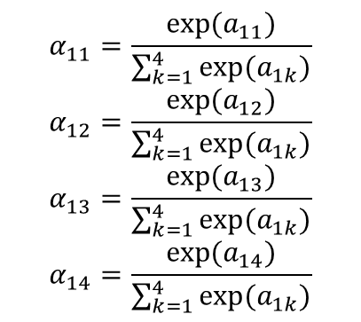
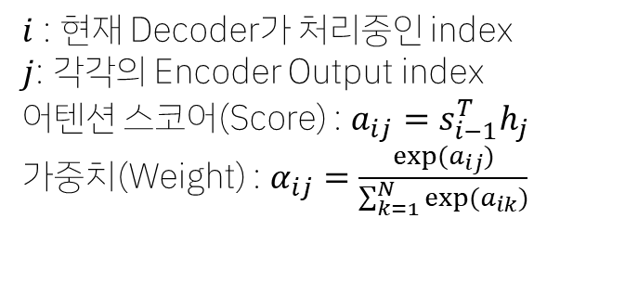
Introduction(Attention)
$$α_{11}=\frac{exp⁡(a_{11})}{\sum_{k=1}^{4}{exp⁡(a_{1k})}}$$
$$α_{12}=\frac{exp⁡(a_{12})}{\sum_{k=1}^{4}{exp⁡(a_{1k})}}$$
$$α_{13}=\frac{exp⁡(a_{13})}{\sum_{k=1}^{4}{exp⁡(a_{1k})}}$$
$$α_{14}=\frac{exp⁡(a_{14})}{\sum_{k=1}^{4}{exp⁡(a_{1k})}}$$
Attention
Value
$$s_{i} :$$
$$s_{1}$$
$$s_{2}$$
$$s_{3}$$
$$s_{4}$$
Attention
Neural
Network
Neural
Network
Neural
Network
Neural
Network
Neural
Network
Output
$h_{j}$ :
$$h_{1}$$
$$h_{2}$$
$$h_{3}$$
$$h_{4}$$
Context
vector
이전
Output
이전
Output
이전
Output
Decoder
Neural
Network
Neural
Network
Neural
Network
Neural
Network
$i$ : 현재 Decoder가 처리중인 index
$j$: 각각의 Encoder Output index
어텐션 스코어(Score) : $a_{ij}=s_{i−1}^{T}h_{j}$
가중치(Weight) : $α_{ij}=\frac{exp⁡(a_{ij})}{\sum_{k=1}^{N}{exp⁡(a_{ik})}}$
Input
이전
Output
Input
이전
Output
Input
이전
Output
Input
Encoder

Slide 15
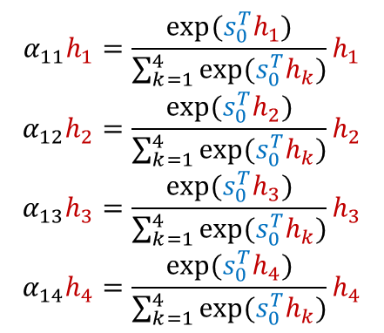
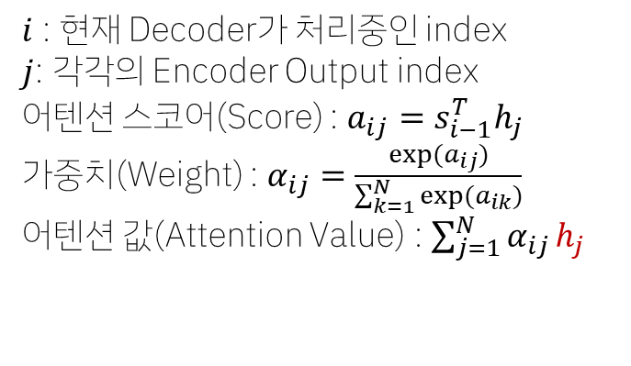
Introduction(Attention)
$$α_{11}h_{1}=\frac{exp⁡(s_{0}^{T}h_{1})}{\sum_{k=1}^{4}{exp⁡(s_{0}^{T}h_{k})}}h_{1}$$
$$α_{12}h_{2}=\frac{exp⁡(s_{0}^{T}h_{2})}{\sum_{k=1}^{4}{exp⁡(s_{0}^{T}h_{k})}}h_{2}$$
$$α_{13}h_{3}=\frac{exp⁡(s_{0}^{T}h_{3})}{\sum_{k=1}^{4}{exp⁡(s_{0}^{T}h_{k})}}h_{3}$$
$$α_{14}h_{4}=\frac{exp⁡(s_{0}^{T}h_{4})}{\sum_{k=1}^{4}{exp⁡(s_{0}^{T}h_{k})}}h_{4}$$
Attention
Value
$$s_{i} :$$
$$s_{1}$$
$$s_{2}$$
$$s_{3}$$
$$s_{4}$$
Attention
Neural
Network
Neural
Network
Neural
Network
Neural
Network
Neural
Network
Output
$h_{j}$ :
$$h_{1}$$
$$h_{2}$$
$$h_{3}$$
$$h_{4}$$
Context
vector
이전
Output
이전
Output
이전
Output
Decoder
Neural
Network
Neural
Network
Neural
Network
Neural
Network
$i$ : 현재 Decoder가 처리중인 index
$j$: 각각의 Encoder Output index
어텐션 스코어(Score) : $a_{ij}=s_{i−1}^{T}h_{j}$
가중치(Weight) : $α_{ij}=\frac{exp⁡(a_{ij})}{\sum_{k=1}^{N}{exp⁡(a_{ik})}}$
어텐션 값(Attention Value) : $\sum_{j=1}^{N}{α_{ij}}h_{j}$
Input
이전
Output
Input
이전
Output
Input
이전
Output
Input
Encoder

Slide 16
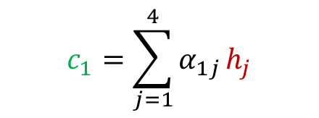

Introduction(Attention)
Attention
Value
$$s_{i} :$$
$$s_{1}$$
$$s_{2}$$
$$s_{3}$$
$$s_{4}$$
$$c_{1}=\sum_{j=1}^{4}{α_{1j}}h_{j}$$
$$c_{1}$$
Attention
Neural
Network
Neural
Network
Neural
Network
Neural
Network
Neural
Network
Output
$h_{j}$ :
$$h_{1}$$
$$h_{2}$$
$$h_{3}$$
$$h_{4}$$
Context
vector
이전
Output
이전
Output
이전
Output
Decoder
Neural
Network
Neural
Network
Neural
Network
Neural
Network
$i$ : 현재 Decoder가 처리중인 index
$j$: 각각의 Encoder Output index
어텐션 스코어(Score) : $a_{ij}=s_{i−1}^{T}h_{j}$
가중치(Weight) : $α_{ij}=\frac{exp⁡(a_{ij})}{\sum_{k=1}^{N}{exp⁡(a_{ik})}}$
어텐션 값(Attention Value) : $\sum_{j=1}^{N}{α_{ij}}h_{j}$
Input
이전
Output
Input
이전
Output
Input
이전
Output
Input
Encoder

Slide 17



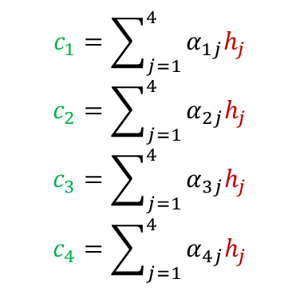
Introduction(Attention)
$$c_{1}=\sum_{j=1}^{4}{α_{1j}h_{j}}$$
$$c_{2}=\sum_{j=1}^{4}{α_{2j}h_{j}}$$
$$c_{3}=\sum_{j=1}^{4}{α_{3j}h_{j}}$$
$$c_{4}=\sum_{j=1}^{4}{α_{4j}h_{j}}$$
Attention
Value
$$s_{i} :$$
$$s_{1}$$
$$s_{2}$$
$$s_{3}$$
$$s_{4}$$
$$c_{1}$$
$$c_{2}$$
$$c_{3}$$
$$c_{4}$$
Attention
Neural
Network
Neural
Network
Neural
Network
Neural
Network
Neural
Network
Output
$h_{j}$ :
$$h_{1}$$
$$h_{2}$$
$$h_{3}$$
$$h_{4}$$
Context
vector
이전
Output
이전
Output
이전
Output
Decoder
Neural
Network
Neural
Network
Neural
Network
Neural
Network
$i$ : 현재 Decoder가 처리중인 index
$j$: 각각의 Encoder Output index
어텐션 스코어(Score) : $a_{ij}=s_{i−1}^{T}h_{j}$
가중치(Weight) : $α_{ij}=\frac{exp⁡(a_{ij})}{\sum_{k=1}^{N}{exp⁡(a_{ik})}}$
어텐션 값(Attention Value) : $\sum_{j=1}^{N}{α_{ij}}h_{j}$
Input
이전
Output
Input
이전
Output
Input
이전
Output
Input
Encoder

Slide 18



Introduction(Attention)
Output
Attention
Neural
Network
Attention
Value
Concatenate
$$h$$
$$s$$
$$s$$
Encoder
Decoder
Context
vector
Input

Slide 19
Introduction(Attention)
Output
Attention
Neural
Network
Attention
Value
Concatenate
$$h$$
$$s$$
$$s$$
Encoder
Decoder
Context
vector
Input

Slide 20

Introduction(Attention)
Output
Attention
Neural
Network
Attention
Value
Concatenate
$$h$$
$$s$$
$$s$$
Encoder
Decoder
Context
vector
Input

Slide 21
Introduction(Attention)
Output
Attention
Neural
Network
Attention
Value
Concatenate
$$h$$
$$s$$
$$s$$
Encoder
Decoder
Context
vector
Input

Slide 22


Introduction(Attention)
Output
Attention
Neural
Network
Attention
Value
Concatenate
$$h$$
$$s$$
$$s$$
Encoder
Decoder
Context
vector
Input

Slide 23
Introduction(Attention)
Output
Attention
Neural
Network
Attention
Value
Concatenate
$$h$$
$$s$$
$$s$$
Encoder
Decoder
Context
vector
Input

Slide 24
Introduction(Attention)
Output
Attention
Neural
Network
Attention
Value
Concatenate
$$h$$
$$s$$
$$s$$
Encoder
Decoder
Context
vector
Input

Slide 25
Introduction(Attention)
Output
Attention
Neural
Network
Attention
Value
Concatenate
$$h$$
$$s$$
$$s$$
Encoder
Decoder
Context
vector
Input

Slide 26
Introduction(Attention)
Output
Attention
Neural
Network
Attention
Value
Concatenate
$$h$$
$$s$$
$$s$$
Encoder
Decoder
Context
vector
Input

Slide 27

Introduction(Attention)
Output
Attention
Neural
Network
Attention
Value
Concatenate
$$h$$
$$s$$
$$s$$
Encoder
Decoder
Context
vector
Input

Slide 28
The limitation of Seq2seq with Attention
Still slow because of sequentially RNN operation
Output
Output
Output
Output
Attention
Neural
Network
Neural
Network
Neural
Network
Neural
Network
Neural
Network
Output
Context
vector
이전
Output
이전
Output
이전
Output
Encoder
Decoder
Neural
Network
Neural
Network
Neural
Network
Neural
Network
Input
이전
Output
Input
이전
Output
Input
이전
Output
Input
Sequentially operation

Slide 29
The limitation of Seq2seq with Attention
Still slow because of sequentially RNN operation -> Can we just use attention?
Output
Output
Output
Output
Attention
Neural
Network
Neural
Network
Neural
Network
Neural
Network
Neural
Network
Output
Context
vector
이전
Output
이전
Output
이전
Output
Encoder
Decoder
Neural
Network
Neural
Network
Neural
Network
Neural
Network
Input
이전
Output
Input
이전
Output
Input
이전
Output
Input

Slide 30
The limitation of Seq2seq with Attention
Can we just use attention? -> Yes! Attention is all you need! -> Transformer
Output
Output
Output
Output
Attention
Neural
Network
Neural
Network
Neural
Network
Neural
Network
Neural
Network
Output
Context
vector
이전
Output
이전
Output
이전
Output
Encoder
Decoder
Neural
Network
Neural
Network
Neural
Network
Neural
Network
Input
Input
Input
Input

Slide 31
The limitation of Seq2seq with Attention
Non-AutoRegressive의 경우
Output
Output
Output
Output
Attention
Neural
Network
Neural
Network
Neural
Network
Neural
Network
Neural
Network
Output
Context
vector
이전
Output
이전
Output
이전
Output
Encoder
Decoder
Neural
Network
Neural
Network
Neural
Network
Neural
Network
Input
이전
Output
Input
이전
Output
Input
이전
Output
Input

Slide 32
The limitation of Seq2seq with Attention
Non-AutoRegressive의 경우
Output
Output
Output
Output
Attention
Neural
Network
Neural
Network
Neural
Network
Neural
Network
Neural
Network
Output
Encoder
Context
vector
Decoder
Neural
Network
Neural
Network
Neural
Network
Neural
Network
Input
Input
Input
Input

Slide 33
Transformer Architecture
with HuggingFace(PyTorch) codes

Slide 34
Transformer Architecture(Embedding)
Architecture
HuggingFace
from transformers import AutoTokenizer
model_ckpt = "bert-base-uncased"
text = "time flies like an arrow"
tokenizer = AutoTokenizer.from_pretrained(model_ckpt)
inputs = tokenizer(text, return_tensors="pt", add_special_tokens=False)
Input Embedding Matrix
time
flies
like
an
arrow
Output

Slide 35
Transformer Architecture(Embedding)
Architecture
HuggingFace
from transformers import AutoTokenizer
model_ckpt = "bert-base-uncased"
text = "time flies like an arrow"
tokenizer = AutoTokenizer.from_pretrained(model_ckpt)
inputs = tokenizer(text, return_tensors="pt", add_special_tokens=False)
print(inputs.input_ids)
Input Embedding Matrix
time
flies
like
an
arrow
2051
10029
2066
2019
8612
Output
tensor([[ 2051, 10029, 2066, 2019, 8612]])

Slide 36
Transformer Architecture(Embedding)
Architecture
임베딩 벡터 차원 = 768
HuggingFace
from transformers import AutoTokenizer
model_ckpt = "bert-base-uncased"
text = "time flies like an arrow"
tokenizer = AutoTokenizer.from_pretrained(model_ckpt)
inputs = tokenizer(text, return_tensors="pt", add_special_tokens=False)
1.8323 | 0.1503 | -1.3515 | … | 0.3707 | -0.0372 | -0.6196
-0.0046 | -0.4413 | 0.6193 | … | -0.6156 | -0.2991 | -1.9867
0.9146 | 0.5156 | -1.1241 | … | 0.0412 | -1.6936 | 0.5268
1.7291 | -0.5051 | -0.0620 | … | -0.5134 | -0.0377 | -0.4892
0.6747 | 0.4967 | -1.0585 | … | -1.4415 | -0.5691 | -0.2328
단어 개수
= 5
inputs_embeds
Input Embedding Matrix
from torch import nn
from transformers import AutoConfig
config = AutoConfig.from_pretrained(model_ckpt)
token_emb = nn.Embedding(config.vocab_size, config.hidden_size)
print(token_emb)
time
flies
like
an
arrow
Output
단어 집합의 크기, 임베딩 벡터 차원
Embedding(30522, 768)
torch.Size([1, 5, 768])
inputs_embeds = token_emb(inputs.input_ids)
print(inputs_embeds.size())
배치 크기, 단어 개수, 임베딩 벡터 차원

Slide 37
Transformer Architecture(Embedding)
Architecture
HuggingFace
class Embeddings(nn.Module):
def __init__(self, config):
def forward(self, input_ids):
Positional Encoding
+
Input Embedding Matrix
time
flies
like
an
arrow
Output
Notes:
- Making a Custom ‘Embedding’ Class

Slide 38
Transformer Architecture(Embedding)
Architecture
HuggingFace
Normalization
class Embeddings(nn.Module):
def __init__(self, config):
super().__init__()
self.token_embeddings = nn.Embedding(
config.vocab_size, config.hidden_size)
self.position_embeddings = nn.Embedding(
config.max_position_embeddings, config.hidden_size)
self.layer_norm = nn.LayerNorm(
config.hidden_size,
eps=1e-12)
self.dropout = nn.Dropout()
Positional Encoding
+
Input Embedding Matrix
time
flies
like
an
arrow
Output
데이터 샘플에 대한 정규화
(1*5*768)
드롭아웃
일부 임베딩 값=0
* ‘Attention Is All You Need’에서는 Normalization이 Add 이전
Notes:
Making a Custom ‘Embedding’ Class
LayerNorm : Normalization by ‘DataSamples’, not ‘BatchSize’
DropOut : Some Embedding values become 0

Slide 39
Transformer Architecture(Embedding)
Architecture
HuggingFace
Normalization
class Embeddings(nn.Module):
def forward(self, input_ids):
# Create position IDs for input sequence
seq_length = input_ids.size(1)
position_ids = torch.arange(seq_length, dtype=torch.long).unsqueeze(0)
# Create token and position embeddings
token_embeddings = self.token_embeddings(input_ids)
position_embeddings = self.position_embeddings(position_ids)
# Combine token and position embeddings
embeddings = token_embeddings + position_embeddings
embeddings = self.layer_norm(embeddings)
embeddings = self.dropout(embeddings)
return embeddings
Positional Encoding
+
Input Embedding Matrix
time
flies
like
an
arrow
Output
데이터 샘플에 대한 정규화
(1*5*768)
드롭아웃
일부 임베딩 값=0
* ‘Attention Is All You Need’에서는 Normalization이 Add 이전
Notes:
- Making a Custom ‘Embedding’ Class

Slide 40



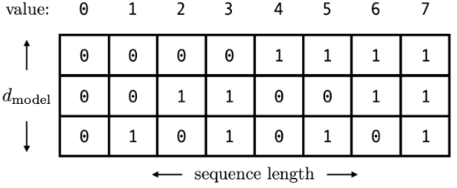
Transformer Architecture(부록 – Positional Encoding)
Simple indexing -> Sequence가 길어지면 index도 증가 -> exploding gradients나 훈련 불안정 발생
Normalize simple indexing -> index 최대값으로 나누기 -> 길이가 달라지면 encoding 의미가 달라짐
Using binary -> 0, 1로만 구성되어 discrete함 -> 이진 벡터를 위치별로 연속적인 encoding 값을 출력하는 함수가 필요
Notes:
- Making a Custom ‘Embedding’ Class

Slide 41
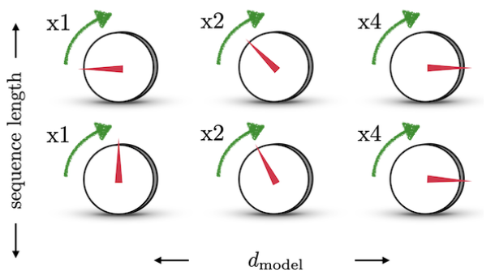
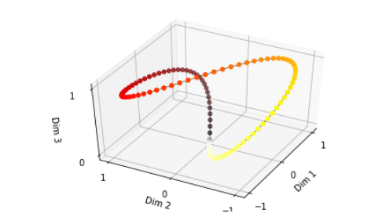
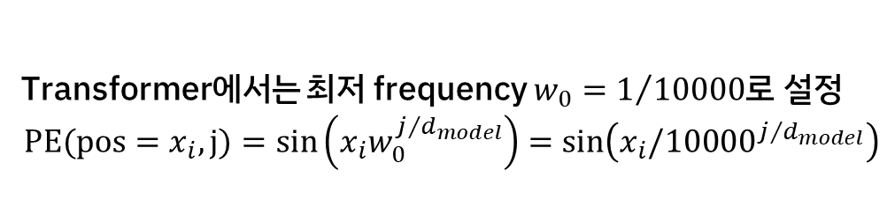

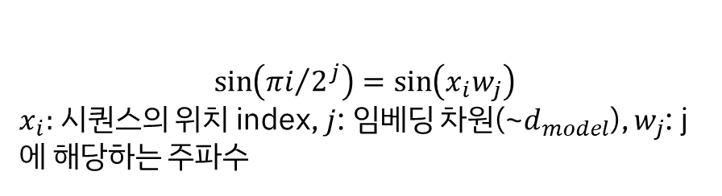

Transformer Architecture(부록 – Positional Encoding)
Continuous binary vector
1. 0, 1 사이를 오가는 함수가 필요함
2. 정규화도 되어있어야 함
1, 2를 만족하는 Sine 함수 사용
왼쪽의 그림처럼 여러 개($d_{model}$) 다이얼들로 음량 레벨
(위치 인덱스)을 조정한다고 할 때, 각각 다이얼 당 한번($i$)에
1칸($π/2$), 2칸($π/4$), 4칸($π/8$)을 움직일 수 있다면
모든 음량 레벨을 적절한 다이얼의 조합으로 표현 가능
$$\sin\left({πi}/{2^{j}}\right)=\sin\left(x_{i}w_{j}\right)$$
$x_{i}:$ 시퀀스의 위치 index, $j$: 임베딩 차원(~$d_{model}$), $w_{j}$: j에 해당하는 주파수
512개 음량 레벨, 8개 다이얼인 경우
1, 2, 4칸… 이면 -> (1+2+4+…+256) 으로 모든 음량 레벨 표현 가능
처음 떨어진 인덱스와 멀리 떨어진 인덱스가 동일!(닫힌 구조)
시퀀스별 위치만 벡터로 나타내면 되기 때문에(PE의 목적)
주기가 굳이 $π/2$일 필요도 없음 -> j에 따라 주파수가 감소
Transformer에서는 최저 frequency $w_{0}=1/{10000}$로 설정
$$PE(pos=x_{i},j)=sin\left(x_{i}w_{0}^{j/{d_{model}}}\right)=\sin\left(x_{i}{/10000}^{j/{d_{model}}}\right)$$
Notes:
512개 음량 레벨인 경우 : 1, 2, 4칸 이면 -> (1+2+4+…+256) 으로 모든 음량 레벨 표현 가능

Slide 42
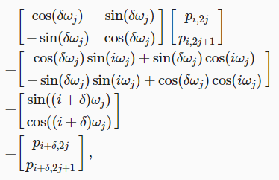
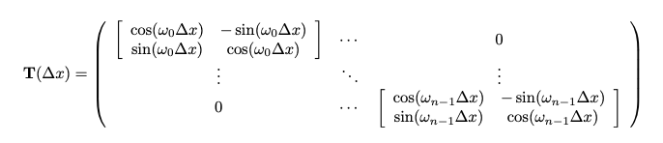


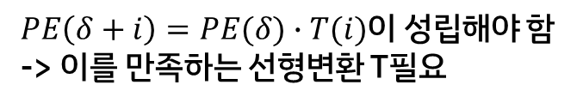
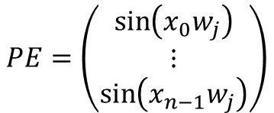
Transformer Architecture(부록 – Positional Encoding)
Continuous binary vector
이제 임베딩 벡터에 위치 정보를 더해야 함 -> PE 행렬 구성 -> 각 단어의 상대적인 위치 정보를 네트워크에게 입력 -> 고정된 위치(기준)를 δ, 인덱스의 위치를 i라 할 때, 고정된 δ에 대한 Positional Encoding 위치 i+δ는 위치 i에서의 선형 dot product로 표현이 가능
$$PE=\left(\begin{matrix}\sin\left(x_{0}w_{j}\right) \\ ⋮ \\ \sin\left(x_{n−1}w_{j}\right)\end{matrix}\right)$$
$PE\left(δ+i\right)=PE(δ)∙T(i)$이 성립해야 함
-> 이를 만족하는 선형변환 T필요
$sin,cos$ 함수가 번갈아 가면서 PE 벡터를 구성
Transformer에서는 최저 frequency $w_{0}=1/{10000}$로 설정
$$PE(pos,2i)=sin\left(pos{/10000}^{{2i}/{d_{model}}}\right)$$
$$PE(pos,2i+1)=cos\left(pos{/10000}^{{2i}/{d_{model}}}\right)$$
Notes:
512개 음량 레벨인 경우 : 1, 2, 4칸 이면 -> (1+2+4+…+256) 으로 모든 음량 레벨 표현 가능

Slide 43
Transformer Architecture(Embedding)
Architecture
임베딩 벡터 차원 = 768
HuggingFace
embedding_layer = Embeddings(config)
print(embedding_layer(inputs.input_ids).size())
0 | 0 | -1.6707 | … | 0 | 0 | 0
0 | 0 | 1.7715 | … | 1.6624 | 0 | 3.4535
0.6546 | -3.0402 | 0 | … | 0 | 0 | -0.7514
0 | 0.0023 | -1.3691 | … | -0.8901 | 1.6307 | 0
0 | 0 | 0 | … | 1.1984 | -0.8702 | -0.4704
단어 개수
= 5
Normalization
Positional Encoding
embedding_layer
+
Input Embedding Matrix
time
flies
like
an
arrow
Output
torch.Size([1, 5, 768])
배치 크기, 단어 개수, 임베딩 벡터 차원
Notes:
- Making a Custom ‘Embedding’ Class

Slide 44
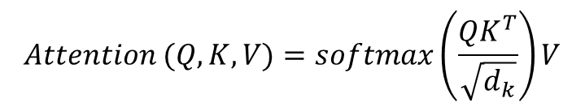
Transformer Architecture(Self-Attention)
Architecture
HuggingFace
임베딩 벡터 차원 = 768
임베딩 벡터 차원 = 768
임베딩 벡터 차원 = 768
import torch
from math import sqrt
query = key = value = inputs_embeds
dim_k = key.size(-1)
scores = torch.bmm(query, key.transpose(1,2)) / sqrt(dim_k)
0 | … | 0
0 | … | 3.4535
0.6546 | … | -0.7514
0 | … | 0
0 | … | -0.4704
0 | … | 0
0 | … | 3.4535
0.6546 | … | -0.7514
0 | … | 0
0 | … | -0.4704
0 | … | 0
0 | … | 3.4535
0.6546 | … | -0.7514
0 | … | 0
0 | … | -0.4704
단어 개수
= 5
Q
단어 개수
= 5
K
단어 개수
= 5
V
Normalization
$$Attention (Q,K,V)=softmax\left(\frac{QK^{T}}{\sqrt{d_{k}}}\right)V$$
Positional Encoding
+
Input Embedding Matrix
time
flies
like
an
arrow
Output

Slide 45
Transformer Architecture(Self-Attention)
Architecture
HuggingFace
임베딩 벡터 차원 = 768
단어 개수 = 5
import torch
from math import sqrt
query = key = value = inputs_embeds
dim_k = key.size(-1)
scores = torch.bmm(query, key.transpose(1,2)) / sqrt(dim_k)
0 | … | 0
0 | … | 3.4535
0.6546 | … | -0.7514
0 | … | 0
0 | … | -0.4704
T
0 | 0 | 0.6 | 0 | 0
… | … | … | … | …
-0.4704 | 0 | -0.7514 | 3.4535 | 0
임베딩 벡터 차원 = 768
단어 개수
= 5
Q
K
V
Normalization
$$Attention (Q,K,V)=softmax\left(\frac{QK^{T}}{\sqrt{d_{k}}}\right)V$$
Positional Encoding
+
Input Embedding Matrix
임베딩 벡터 차원 수(768)
time
flies
like
an
arrow
Output

Slide 46

Transformer Architecture(Self-Attention)
Architecture
HuggingFace
import torch
from math import sqrt
query = key = value = inputs_embeds
dim_k = key.size(-1)
scores = torch.bmm(query, key.transpose(1,2)) / sqrt(dim_k)
0 | … | 0
0 | … | 3.4535
0.6546 | … | -0.7514
0 | … | 0
0 | … | -0.4704
0 | 0 | 0.6 | 0 | 0
… | … | … | … | …
-0.4704 | 0 | -0.7514 | 3.4535 | 0
임베딩 벡터 차원 = 768
dot
$$÷\sqrt{d_{k}}$$
Q
K
V
Normalization
$$Attention (Q,K,V)=softmax\left(\frac{QK^{T}}{\sqrt{d_{k}}}\right)V$$
Positional Encoding
+
Input Embedding Matrix
time
flies
like
an
arrow
Output

Slide 47
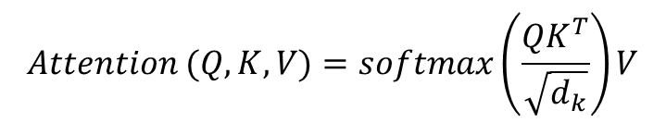


Transformer Architecture(Self-Attention)
Architecture
HuggingFace
5
import torch
from math import sqrt
query = key = value = inputs_embeds
dim_k = key.size(-1)
scores = torch.bmm(query, key.transpose(1,2)) / sqrt(dim_k)
print(scores.size())
import torch.nn.functional as F
weights = F.softmax(scores, dim=-1)
0 | 0 | -1.6707 | 0 | 0
0 | 0 | 1.7715 | 0 | 3.4535
0.6546 | -3.0402 | 0 | 0 | -0.7514
0 | 0.0023 | -1.3691 | 1.6307 | 0
0 | 0 | 0 | -0.8702 | -0.4704
$$softmax($$
$$)$$
5
Q
K
V
Normalization
Positional Encoding
+
Input Embedding Matrix
time
flies
like
an
arrow
Output
$$Attention (Q,K,V)=softmax\left(\frac{QK^{T}}{\sqrt{d_{k}}}\right)V$$
torch.Size([1, 5, 5])

Slide 48


Transformer Architecture(Self-Attention)
Architecture
HuggingFace
5
임베딩 벡터 차원 = 768
import torch
from math import sqrt
query = key = value = inputs_embeds
dim_k = key.size(-1)
scores = torch.bmm(query, key.transpose(1,2)) / sqrt(dim_k)
print(scores.size())
import torch.nn.functional as F
weights = F.softmax(scores, dim=-1)
attn_outputs = torch.bmm(weights, value)
print(attn_outputs.shape)
0 | 0 | -1.6707 | 0 | 0
0 | 0 | 1.7715 | 0 | 3.4535
0.6546 | -3.0402 | 0 | 0 | -0.7514
0 | 0.0023 | -1.3691 | 1.6307 | 0
0 | 0 | 0 | -0.8702 | -0.4704
0 | … | 0
0 | … | 3.4535
0.6546 | … | -0.7514
0 | … | 0
0 | … | -0.4704
$$softmax($$
$$)$$
5
Q
K
단어 개수
= 5
V
Normalization
Positional Encoding
+
Input Embedding Matrix
time
flies
like
an
arrow
Output
$$Attention (Q,K,V)=softmax\left(\frac{QK^{T}}{\sqrt{d_{k}}}\right)V$$
torch.Size([1, 5, 5])
torch.Size([1, 5, 768])
배치 크기, 단어 개수, 임베딩 벡터 차원
= embedding_layer와 동일한 size
= Output을 Input으로 다시 활용할 수 있다!!

Slide 49
Transformer Architecture(Self-Attention)
Architecture
HuggingFace
MatMul(BMM)
import torch
from math import sqrt
import torch.nn.functional as F
def scaled_dot_product_attention(
query, key, value):
dim_k = query.size(-1)
scores = torch.bmm(query, key.transpose(1, 2)) / sqrt(dim_k)
weights = F.softmax(scores, dim=-1)
return torch.bmm(weights, value)
SoftMax
Mask (opt.)
Scale
MatMul(BMM)
Q
K
V
Normalization
Positional Encoding
+
Input Embedding Matrix
time
flies
like
an
arrow
Output
$$Attention (Q,K,V)=softmax\left(\frac{QK^{T}}{\sqrt{d_{k}}}\right)V$$
* 책에서는 bmm을 사용

Slide 50
Transformer Architecture(Self-Attention)
Architecture
HuggingFace
import torch
from math import sqrt
import torch.nn.functional as F
def scaled_dot_product_attention(
query, key, value):
dim_k = query.size(-1)
scores = torch.bmm(query, key.transpose(1, 2)) / sqrt(dim_k)
weights = F.softmax(scores, dim=-1)
return torch.bmm(weights, value)
Scaled Dot-Product Attention
Q
K
V
Normalization
Positional Encoding
+
Input Embedding Matrix
time
flies
like
an
arrow
Output
$$Attention (Q,K,V)=softmax\left(\frac{QK^{T}}{\sqrt{d_{k}}}\right)V$$

Slide 51
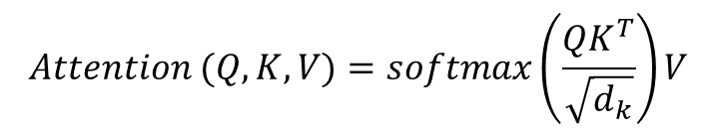
Transformer Architecture(Self-Attention)
Architecture
HuggingFace
class AttentionHead(nn.Module):
def __init__(self, embed_dim, head_dim):
super().__init__()
self.q = nn.Linear(embed_dim, head_dim)
self.k = nn.Linear(embed_dim, head_dim)
self.v = nn.Linear(embed_dim, head_dim)
def forward(self, hidden_state):
attn_outputs = scaled_dot_product_attention(
self.q(hidden_state),
self.k(hidden_state),
self.v(hidden_state)
)
return attn_outputs
Scaled Dot-Product Attention
선형변환
Linear
Linear
Linear
Q
K
V
Normalization
Positional Encoding
+
Input Embedding Matrix
time
flies
like
an
arrow
Output
$$Attention (Q,K,V)=softmax\left(\frac{QK^{T}}{\sqrt{d_{k}}}\right)V$$

Slide 52
Transformer Architecture(Self-Attention)
Architecture
HuggingFace
Linear
class MultiHeadAttention(nn.Module):
def __init__(self, config):
super().__init__()
embed_dim = config.hidden_size
num_heads = config.num_attention_heads
head_dim = embed_dim // num_heads
self.heads = nn.ModuleList(
[AttentionHead(embed_dim, head_dim) for _ in range(num_heads)]
)
self.output_linear = nn.Linear(
embed_dim, embed_dim)
num_heads
Scaled Dot-Product Attention
num_heads
Linear
Linear
Linear
Q
K
V
Normalization
Positional Encoding
+
Input Embedding Matrix
time
flies
like
an
arrow
Output

Slide 53
Transformer Architecture(Self-Attention)
Architecture
Linear
HuggingFace
Concat
class MultiHeadAttention(nn.Module):
def __init__(self, config):
super().__init__()
embed_dim = config.hidden_size
num_heads = config.num_attention_heads
head_dim = embed_dim // num_heads
self.heads = nn.ModuleList(
[AttentionHead(embed_dim, head_dim) for _ in range(num_heads)]
)
self.output_linear = nn.Linear(
embed_dim, embed_dim)
def forward(self, hidden_state):
x = torch.cat(
[h(hidden_state) for h in self.heads], dim=-1)
x = self.output_linear(x)
return x
num_heads
Scaled Dot-Product Attention
num_heads
Linear
Linear
Linear
주어진 차원을 기준으로
주어진 텐서들을 붙임
(concatenate)
Out_feature = 64
In_feature = 768
-> 12*64=768
-> 선형 변환
-> torch.Size([1, 5, 768])
Q
K
V
Normalization
Positional Encoding
+
Input Embedding Matrix
time
flies
like
an
arrow
Output
* BERT has 12 attention heads

Slide 54
Transformer Architecture(Self-Attention)
Architecture
HuggingFace
multihead_attn = MultiHeadAttention(config)
attn_output = multihead_attn(inputs_embeds)
print(attn_output.size())
Multi-Head Attention
Q
K
V
Normalization
Positional Encoding
+
Input Embedding Matrix
time
flies
like
an
arrow
Output
torch.Size([1, 5, 768])
배치 크기, 단어 개수, 임베딩 벡터 차원
= embedding_layer와 동일한 size
= Output을 Input으로 다시 활용할 수 있다!!

Slide 55


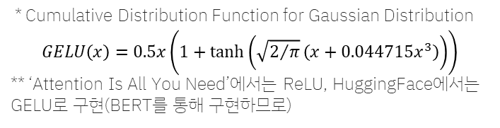
Transformer Architecture(Feed-Forward Layer)
Architecture
Dropout
Mathematical expression
Linear
$$Linear\left(x\right)=W_{1}x+b_{1}$$
$$GELU\left(x\right)=x∗Φ\left(x\right)$$
GELU
Linear
Multi-Head Attention
$$FeedForwardNetwork\left(x\right)=W_{2}\left(\left(W_{1}x+b_{1}\right)∗Φ\left(\left(W_{1}x+b_{1}\right)\right)\right)+b_{2}$$
Q
K
V
$$FeedForwardNetwork\left(x\right)=W_{2}max\left(0,W_{1}x+b_{1}\right)+b_{2}$$
Normalization
Positional Encoding
+
Input Embedding Matrix
time
flies
like
an
arrow
Output
* Cumulative Distribution Function for Gaussian Distribution
$$GELU\left(x\right)=0.5x\left(1+tanh⁡\left(\sqrt{2/π}\left(x+0.044715x^{3}\right)\right)\right)$$
** ‘Attention Is All You Need’에서는 ReLU, HuggingFace에서는 GELU로 구현(BERT를 통해 구현하므로)

Slide 56
Transformer Architecture(Feed-Forward Layer)
Architecture
Dropout
HuggingFace
Linear
class FeedForward(nn.Module):
def __init__(self, config):
super().__init__()
self.linear_1 = nn.Linear(config.hidden_size,
config.intermediate_size)
self.linear_2 = nn.Linear(config.intermediate_size,
config.hidden_size)
self.gelu = nn.GELU()
self.dropout = nn.Dropout(config.hidden_dropout_prob)
def forward(self, x):
x = self.linear_1(x)
x = self.gelu(x)
x = self.linear_2(x)
x = self.dropout(x)
return x
GELU
Linear
Multi-Head Attention
Q
K
V
Normalization
Positional Encoding
+
Input Embedding Matrix
time
flies
like
an
arrow
Output

Slide 57
Transformer Architecture(Feed-Forward Layer)
Architecture
HuggingFace
class FeedForward(nn.Module):
def __init__(self, config):
super().__init__()
self.linear_1 = nn.Linear(config.hidden_size,
config.intermediate_size)
self.linear_2 = nn.Linear(config.intermediate_size,
config.hidden_size)
self.gelu = nn.GELU()
self.dropout = nn.Dropout(config.hidden_dropout_prob)
def forward(self, x):
x = self.linear_1(x)
x = self.gelu(x)
x = self.linear_2(x)
x = self.dropout(x)
return x
Feed-Forward Layer
Multi-Head Attention
Q
K
V
Normalization
Positional Encoding
+
Input Embedding Matrix
time
flies
like
an
arrow
Output

Slide 58
Transformer Architecture(Adding Layer Normalization)
Architecture
HuggingFace
+
class TransformerEncoderLayer(nn.Module):
def __init__(self, config):
super().__init__()
self.layer_norm_1 = nn.LayerNorm(
config.hidden_size)
self.layer_norm_2 = nn.LayerNorm(
config.hidden_size)
self.attention = MultiHeadAttention(config)
self.feed_forward = FeedForward(config)
def forward(self, x):
# Apply layer normalization and then copy input into query, key, value
hidden_state = self.layer_norm_1(x)
# Apply attention with a skip connection
x = x + self.attention(hidden_state)
# Apply feed-forward layer with a skip connection
x = x + self.feed_forward(
self.layer_norm_2(x))
return x
Feed-Forward Layer
Normalization
+
Multi-Head Attention
Q
K
V
Normalization
Positional Encoding
+
Input Embedding Matrix
time
flies
like
an
arrow
Output
* ‘Attention Is All You Need’에서는 Normalization이 Add 이전

Slide 59
Transformer Architecture(Adding Layer Normalization)
Architecture
HuggingFace
+
encoder_layer = TransformerEncoderLayer(config)
print(inputs_embeds.shape, encoder_layer(inputs_embeds).size())
Feed-Forward Layer
Normalization
+
Multi-Head Attention
Q
K
V
Normalization
Positional Encoding
+
Input Embedding Matrix
time
flies
like
an
arrow
Output
torch.Size([1, 5, 768]) torch.Size([1, 5, 768])
배치 크기, 단어 개수, 임베딩 벡터 차원
= embedding_layer와 동일한 size
= Output을 Input으로 다시 활용할 수 있다!!
* ‘Attention Is All You Need’에서는 Normalization이 Add 이전

Slide 60
Transformer Architecture(Transformer Encoder)
Architecture
HuggingFace
+
class TransformerEncoder(nn.Module):
def __init__(self, config):
super().__init__()
self.embeddings = Embeddings(config)
self.layers = nn.ModuleList([TransformerEncoderLayer(config)
for _ in range(config.num_hidden_layers)])
def forward(self, x):
x = self.embeddings(x)
for layer in self.layers:
x = layer(x)
return x
encoder = TransformerEncoder(config)
print(encoder(inputs.input_ids).size())
Feed-Forward Layer
Normalization
+
Multi-Head Attention
Q
K
V
Normalization
Positional Encoding
+
Input Embedding Matrix
time
flies
like
an
arrow
Output
torch.Size([1, 5, 768]) torch.Size([1, 5, 768])
배치 크기, 단어 개수, 임베딩 벡터 차원
= embedding_layer와 동일한 size
= Output을 Input으로 다시 활용할 수 있다!!
* ‘Attention Is All You Need’에서는 Normalization이 Add 이전

Slide 61

Transformer Architecture(Transformer Encoder)
Architecture
HuggingFace
Encoder
class TransformerEncoder(nn.Module):
def __init__(self, config):
super().__init__()
self.embeddings = Embeddings(config)
self.layers = nn.ModuleList([
TransformerEncoderLayer(config)
for _ in
range(config.num_hidden_layers)
])
def forward(self, x):
x = self.embeddings(x)
for layer in self.layers:
x = layer(x)
return x
encoder = TransformerEncoder(config)
print(encoder(inputs.input_ids).size())
$$×n$$
Encoder
Encoder
Positional Encoding
+
Input Embedding Matrix
time
flies
like
an
arrow
Output
torch.Size([1, 5, 768])
배치 크기, 단어 개수, 임베딩 벡터 차원
= embedding_layer와 동일한 size
= Output을 Input으로 다시 활용할 수 있다!!

Slide 62

Transformer Architecture(Transformer Encoder)
Architecture
HuggingFace
class TransformerEncoder(nn.Module):
def __init__(self, config):
super().__init__()
self.embeddings = Embeddings(config)
self.layers = nn.ModuleList([
TransformerEncoderLayer(config)
for _ in
range(config.num_hidden_layers)
])
def forward(self, x):
x = self.embeddings(x)
for layer in self.layers:
x = layer(x)
return x
encoder = TransformerEncoder(config)
print(encoder(inputs.input_ids).size())
Encoder
$$×n$$
Encoder
Encoder
Positional Encoding
+
Input Embedding Matrix
time
flies
like
an
arrow
Output
torch.Size([1, 5, 768])
배치 크기, 단어 개수, 임베딩 벡터 차원
= embedding_layer와 동일한 size
= Output을 Input으로 다시 활용할 수 있다!!

Slide 63
Transformer Architecture(Transformer Decoder)
Architecture
HuggingFace
seq_len = inputs.input_ids.size(-1)
mask = torch.tril(
torch.ones(seq_len, seq_len)
).unsqueeze(0)
print(mask[0])
Masked Multi-Head Attention
Q
K
V
Normalization
Positional Encoding
+
Output Embedding Matrix
Die
Zeit
fliegt
wie
ein
Output
tensor([ [1., 0., 0., 0., 0.],
[1., 1., 0., 0., 0.],
[1., 1., 1., 0., 0.],
[1., 1., 1., 1., 0.],
[1., 1., 1., 1., 1.]])
* ‘Attention Is All You Need’에서는 Normalization이 Add 이전

Slide 64
Transformer Architecture(Transformer Decoder)
Architecture
HuggingFace
def scaled_dot_product_attention(query, key, value):
. . .
seq_len = inputs.input_ids.size(-1)
mask = torch.tril(
torch.ones(seq_len, seq_len)
).unsqueeze(0)
print(scores.masked_fill(mask == 0, float(“-inf")))
. . .
Masked Multi-Head Attention
Q
K
V
Normalization
Positional Encoding
+
Output Embedding Matrix
Die
Zeit
fliegt
wie
ein
Output
tensor([[ [ 0.2058, -inf, -inf, -inf, -inf],
[-0.3525, 0.3416, -inf, -inf, -inf],
[ 0.2654, 0.0971, -0.0415, -inf, -inf],
[-0.6559, 0.2627, 0.7504, 0.1347, -inf],
[ 0.1747, 0.3085, -0.1122, -0.0575, 0.4298]]],
grad_fn=<MaskedFillBackward0>
* ‘Attention Is All You Need’에서는 Normalization이 Add 이전

Slide 65
Transformer Architecture(Transformer Decoder)
Architecture
HuggingFace
def scaled_dot_product_attention(query, key, value, mask=None):
dim_k = query.size(-1)
scores = torch.bmm(
query, key.transpose(1, 2)) / sqrt(dim_k)
if mask is not None:
scores = scores.masked_fill(
mask == 0, float("-inf"))
weights = F.softmax(scores, dim=-1)
return weights.bmm(value)
Masked Multi-Head Attention
Q
K
V
Normalization
Positional Encoding
+
Output Embedding Matrix
Die
Zeit
fliegt
wie
ein
Output
* ‘Attention Is All You Need’에서는 Normalization이 Add 이전

Slide 66
Transformer Architecture(Transformer Decoder)
Architecture
+
HuggingFace
Feed-Forward Layer
class TransformerDecoderLayer(nn.Module):
def __init__(self, config):
super().__init__()
self.layer_norm_1 =
nn.LayerNorm(config.hidden_size)
self.layer_norm_2 =
nn.LayerNorm(config.hidden_size)
self.layer_norm_3 =
nn.LayerNorm(config.hidden_size)
self.masked_attention =
MultiHeadAttention(config)
self.enc_dec_attention =
MultiHeadAttention(config)
self.feed_forward = FeedForward(config)
Normalization
Encoder K,V
+
Multi-Head Attention
Normalization
Masked Multi-Head Attention
Q
K
V
Normalization
Positional Encoding
+
Output Embedding Matrix
Die
Zeit
fliegt
wie
ein
Output
* ‘Attention Is All You Need’에서는 Normalization이 Add 이전

Slide 67
Transformer Architecture(Transformer Decoder)
Architecture
+
HuggingFace
Feed-Forward Layer
class TransformerDecoderLayer(nn.Module):
def forward(self, x, encoder_state):
hidden_state = self.layer_norm_1(x)
x = x + self.masked_attention(hidden_state)
x = self.layer_norm_3(x)
if encoder_state is not None:
x = x +
self.enc_dec_attention(
encoder_state)
x = x + self.feed_forward(
self.layer_norm_3(x))
return x
Normalization
Encoder K,V
+
Multi-Head Attention
Normalization
Masked Multi-Head Attention
Q
K
V
Normalization
Positional Encoding
+
Output Embedding Matrix
Die
Zeit
fliegt
wie
ein
Output
* ‘Attention Is All You Need’에서는 Normalization이 Add 이전

Slide 68
Transformer Architecture(Transformer Decoder)
Architecture
+
HuggingFace
Feed-Forward Layer
decoder_layer = TransformerDecoderLayer(config)
print(inputs_embeds.shape, decoder_layer(inputs_embeds, encoder(inputs.input_ids)).size())
Normalization
Encoder K,V
+
Multi-Head Attention
Normalization
Masked Multi-Head Attention
Q
K
V
Normalization
Positional Encoding
+
Output Embedding Matrix
Die
Zeit
fliegt
wie
ein
Output
torch.Size([1, 5, 768]) torch.Size([1, 5, 768])
배치 크기, 단어 개수, 임베딩 벡터 차원
= embedding_layer와 동일한 size
= Output을 Input으로 다시 활용할 수 있다!!
* ‘Attention Is All You Need’에서는 Normalization이 Add 이전

Slide 69
Transformer Architecture(Transformer Decoder)
Architecture
Output
Probabilities
HuggingFace
class TransformerDecoder(nn.Module):
def __init__(self, config):
super().__init__()
self.embeddings = Embeddings(config)
self.layers = nn.ModuleList([
TransformerDecoderLayer(config)
for _ in range(
config.num_hidden_layers)])
def forward(self, x, encoder_state):
x = self.embeddings(x)
for layer in self.layers:
x = layer(x, encoder_state)
return x
Encoder K,V
Decoder
$$×n$$
Decoder
Decoder
Positional Encoding
+
Output Embedding Matrix
Die
Zeit
fliegt
wie
ein
Output

Slide 70
Transformer Architecture(Transformer Decoder)
Architecture
Output
Probabilities
HuggingFace
class TransformerDecoder(nn.Module):
def __init__(self, config):
super().__init__()
self.embeddings = Embeddings(config)
self.layers = nn.ModuleList([
TransformerDecoderLayer(config)
for _ in range(
config.num_hidden_layers)])
def forward(self, x, encoder_state):
x = self.embeddings(x)
for layer in self.layers:
x = layer(x, encoder_state)
return x
Encoder K,V
Decoder
$$×n$$
Decoder
Decoder
Positional Encoding
+
Output Embedding Matrix
Die
Zeit
fliegt
wie
ein
Output

Slide 71
Transformer Architecture(Transformer Decoder)
Architecture
Output
Probabilities
HuggingFace
decoder = TransformerDecoder(config)
print(decoder(inputs.input_ids, encoder(inputs.input_ids)).size())
Encoder K,V
Decoder
$$×n$$
Decoder
Decoder
Positional Encoding
+
Output Embedding Matrix
Die
Zeit
fliegt
wie
ein
Output
torch.Size([1, 5, 768])

Slide 72


Transformer Architecture
Architecture
Output
Probabilities
Encoder K,V
Encoder
Decoder
$$×n$$
Encoder
Decoder
$$×n$$
Encoder
Decoder
Positional Encoding
+
Positional Encoding
+
Input Embedding Matrix
Output Embedding Matrix
input
output
* ‘Attention Is All You Need’에서는 Normalization이 Add 이전

Slide 73
Interface
Huggingface & PyTorch

Slide 74
Interface – Tokenizer
class transformers.PreTrainedTokenizerBase
class attribures vocab_files_names (Dict[str, str])
dict 형태로, key 값으로는 vocab file 의 keyword name을 저장하고, value 값으로는 filename 저장
class attribures pretrained_vocab_files_map (Dict[str, Dict[str, str]])
dict의 형태로, key 값으로는 vocab file의 keyword name을 저장하고, value 값으로는 또 다른 dict 형태를 저장하는데, 해당 dict의 key로는 모델의 short-cut-name, value로는 해당 모델의 pretrained vocabulary file의 url
class attribures padding_side, truncation_side (str)
Padding과 truncation이 어느 쪽에 추가되어야 하는지 (right 또는 left)
class attribures model_input_names (List[str])
모델의 forward pass에서 예상되는 입력 목록
class attribures max_model_input_sizes (Dict[str, Optional[int]])
dict 형태로, key값으로는 모델의 이름, value 값으로는 모델의 입력으로 받을 수 있는 최대 입력 길이
class attribures pretrained_init_configuration (Dict[str, Dict[str, Any]])
from_pretrained()로 Tokenizer를 load할 때 pre-trained model에 대한 Tokenizer 클래스의 __init__ 메서드에 전달할 특정 인수의 Dictionary를 Key로 사용하고 pre-trained model의 short-cut name을 Value 값으로 포함하는 dictionary 방법.

Slide 75
Interface – Tokenizer
class transformers.PreTrainedTokenizerBase
parameters model_max_length(int, optional)
Transformer 모델의 입력을 받을 수 있는 최대의 입력 길이
parameters padding_side(str, optional)
padding을 어느 위치에 추가할 것인지 (right 또는 left)
parameters model_input_names (List[string], optional)
forward pass에서 모델의 입력으로 받을 값들의 key 값 (예를 들어, token_type_ids, attention_mask 등)
parameters bos_token (str or tokenizers.AddedToken, optional)
문장의 시작을 나타내는 special token → self.bos_token, self.bos_token_id
parameters eos_token (str or tokenizers.AddedToken, optional)
문장의 끝을 나타내는 Special token → self.eos_token, self.eos_token_id
parameters unk_token (str or tokenizers.AddedToken, optional)
모르는 단어를 나타내는 special token → self.unk_token, self.unk_token_id
parameters sep_token (str or tokenizers.AddedToken, optional)
두 개의 문장이 있는 경우, 두 문장을 구분하는 special token (BERT 등에서 사용) → self.sep_token, self.sep_token_id
parameters pad_token (str or tokenizers.AddedToken, optional)
동일한 batch 내에서 입력의 크기를 동일하게 하기 위해서 사용해는 padding token → self.pad_token, self.pad_token_id

Slide 76
Interface – Tokenizer
class transformers.PreTrainedTokenizerBase
parameters cls_token (str or tokenizers.AddedToken, optional)
입력의 class를 나타내는 special token (BERT 등에서 사용) → self.cls_token, self.cls_token_id
parameters mask_token (str or tokenizers.AddedToken, optional)
masked-language modeling 을 할 때 사용되는 mask token → self.mask_token, self.mask_token_id
parameters additional_special_tokens (tuple or list of str or tokenizers.AddedToken, optional)
추가적인 Special token의 목록. Tokenizer에 의해서 분리되지 않도록 리스트로 유지
function __call__ (실행한 경우)
parameters text (str, List[str], List[List[str]])
encoding 될 문장 (sequence, batch). str, List[str], List[List[str]] 을 입력으로 받을 수 있고, 이미 tokenize 된 경우(list of tokens) is_split_into_words=True 로 지정해줘야 함
parameters text_pair (str, List[str], List[List[str]])
text와 동일. 한 개의 문장이 아니라 sentence pair를 입력으로 주는 경우
parameters add_special_tokens (bool, optional, defaults to True)
encoding을 할 때 special token을 추가할지 여부

Slide 77
Interface – Tokenizer
class transformers.PreTrainedTokenizerBase
function __call__ (실행한 경우)
parameters padding (bool, str or PaddingStrategy, optional, defaults to False)
True로 지정한 경우 batch 내에서 가장 긴 길이에 맞춰서 padding을 한다. False인 경우 padding을 하지 않고 encoding을 한다. 'max_length'로 지정하면 모델이 입력으로 받을 수 있는 최대의 길이에 맞춰서 padding을 한다.
parameters truncation (bool, str or TruncationStrategy, optional, defaults to False)
True 인 경우 모델이 입력으로 받을 수 있는 최대의 길이에 맞춰서 Truncation을 한다. "only_first"인 경우 sentence pair로 입력이 주어지는 경우, 첫 번째 문장만 Truncate 한다. 반대로, "only_second"인 경우 두 번째 문장만 truncate 한다. False로 지정한 경우 trauncate을 하지 않는다.
parameters max_length (int, optional)
모델이 입력으로 받을 최대의 입력 길이. 별도로 지정하지 않은 경우 모델의 config에 맞게 지정
parameters is_split_into_words (int, optional, defaults to 0)
입력이 이미 tokenize가 되었는지 여부. True로 지정한 경우, 입력이 이미 tokenize가 되었다고 가정하고 별도의 Tokenize를 수행하지 않음
parameters return_tensors (str or TensorType, optional)
"tf" 면 tf.constant, "pt" 면 torch.Tensor, "np" 면 np.ndarray 로 결과를 리턴
parameters return_token_type_ids (bool, optional)
return_token_type_ids : token type id를 제공할지 여부. 기본적으로 제공
Notes:
- Token type id 란? (segment id 라고도 부름) BERT와 같은 모델에서는 입력으로 2개의 문장이 주어지는 경우가 있다. 입력으로 문장이 2개가 주어진 경우, 두 문장을 구분할 수 있도록 별도의 id를 부여한다. 2개의 문장이 입력으로 주어지면, 첫 번째 문장에 해당하는 token들의 인덱스에는 모두 0을, 두 번째 문장에 해당하는 token들의 인덱스에는 모두 1을 부여

Slide 78
Interface – Tokenizer
class transformers.PreTrainedTokenizerBase
function __call__ (실행한 경우)
parameters return_attention_mask (bool, optional)
attention mask를 제공할지 여부. 기본적으로 제공함.
parameters return_special_tokens_mask (bool, optional, defaults to False)
special token mask를 리턴할지 여부
parameters return_length (bool, optional, defaults to False)
encode된 결과의 길이를 리턴할지 여부
parameters verbose (bool, optional, defaults to True)
추가적인 출력이나 warning 등을 출력할지 여부, 리턴 → BachEncoding
returns input_ids
token is 의 리스트
returns token_type_ids
token type id의 리스트
returns attention_mask
모델에 의해서 attention이 수행되어야 하는 인덱스

Slide 79
Interface – Tokenizer
class transformers.PreTrainedTokenizerBase
function __call__ (실행한 경우)
returns num_truncated_tokens
truncate된 token의 개수
returns special_token_mask
0인 경우 일반 Token, 1인 경우 Special token
returns length
return_length=True 인 경우, encoding 된 출력의 길이
기타 함수들
function batch_decode()
token id로 구성된 입력을 하나의 연결된 string으로 출력한다. (decode() 함수 호출)
function convert_ids_to_tokens()
한 개의 token id 또는 token id 의 리스트를 token으로 변환한다. skip_special_tokens=True로 하면 decoding할 때 special token들을 제거

Slide 80
Interface – Tokenizer
class transformers.PreTrainedTokenizerBase
기타 함수들
function convert_tokens_to_ids()
token string 또는 token string의 리스트를 token id 또는 Token id의 리스트로 변환
function convert_tokens_to_string()
token의 리스트를 하나의 연결된 String으로 변환한다. (" ".join(tokens) 와 동일한 연산)
function decode()
tokenizer 와 vocabulary를 이용해서 token id를 string으로 변환한다. skip_special_token=True로 지정하면 speical token들을 제외한다.
function encode()
token string을 token id 의 리스트로 변환한다. add_special_tokens=False로 지정하면 token id로 변환할 때 special token들을 제외한다. padding을 통해서 padding token을 어떻게 추가할지도 지정할 수 있다. (True, "max_length", False)
function truncation()
truncation을 수행 (True, "only_first", "only_second", False)
function get_added_vocab()
token to index에 해당하는 dict를 리턴한다.

Slide 81
Interface – Tokenizer
class transformers.PreTrainedTokenizerBase
기타 함수들
function tokenize()
tokenizer를 이용해서 string을 token id의 리스트로 변환한다.

Slide 82
Interface – Model
class transformers.PreTrainedModel
전체 함수들
function from_pretrained()
Pretrained model을 instantiate 한다. 기본적으로 model.eval() 로 설정되어있기 때문에 학습을 하기 위해서는 model.train()으로 모드를 변경해줘야 한다.
function save_pretrained()
모델과 해당 모델의 configuration을 특정한 디렉토리에 저장한다. save_directory 로 해당 값들을 저장할 위치를 지정할 수 있다.
load config → load model → instantiate model (load weights) → model.eval() (gradient 계산하지 않도록)
function get_input_embeddings() , get_output_embeddings()
Input embedding은 vocabulary 에서 hidden state로 mapping하고, output embedding은 hidden state에서 vocabulary로 mapping하는 역할을 수행한다.
function set_input_embeddings()
모델의 input embedding을 새로 지정한다.

Slide 83
Interface – Model
class transformers.PreTrainedModel
전체 함수들
function resize_token_embeddings()
new_num_tokens 로 지정한 크기만큼의 임베딩을 생성한다. 기존의 임베딩 크기보다 new_num_tokens가 더 크다면 임베딩 제일 뒤에 새로운 임베딩들을 추가하고, 더 작다면 뒤에서부터 임베딩을 삭제해서 임베딩의 크기를 줄인다. new_num_tokens를 지정하지 않는 경우는 그냥 임베딩의 포인터를 리턴한다.
function tie_weights()
input embedding과 output embedding을 묶는다. (input weight를 가지고와서 output weight으로 지정해준다.) (output.weight = input.weight) torchscript flag가 config 파일에 지정되어 있다면, input weight을 clone해서 output weight으로 지정해준다.

